Slide 2
What is Backtracking Algorithm?
Backtracking is an algorithmic strategy for solving problems recursively by attempting to slowly construct a solution, one piece at a time, and discarding those solutions that fail to satisfy the constraints of the issue at any point in the given time.

Slide 3
What is Backtracking Algorithm?
Types of Backtracking Algorithms
Backtracking encompasses three distinct problem-solving approaches:
Decision-making: This type involves finding a feasible solution.
2. Optimization: The objective here is to search for the best possible solution.
3. Enumeration: In this scenario, the aim is to identify and generate all solvable options.

Slide 4
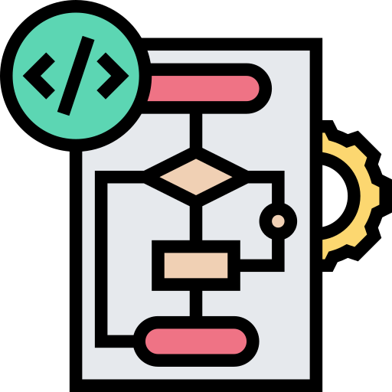
Types of Backtracking Algorithm
Types:
Recursive
Non-Recursive

Slide 5

Recursive Backtracking
Recursion - programming concept which a function calls itself during execution.
Recursive Backtracking
State space or decision tree
Start a root node and recursively explores each possible solution if the solution is valid then saved but if not it will backtrack and find another solution.

Slide 6
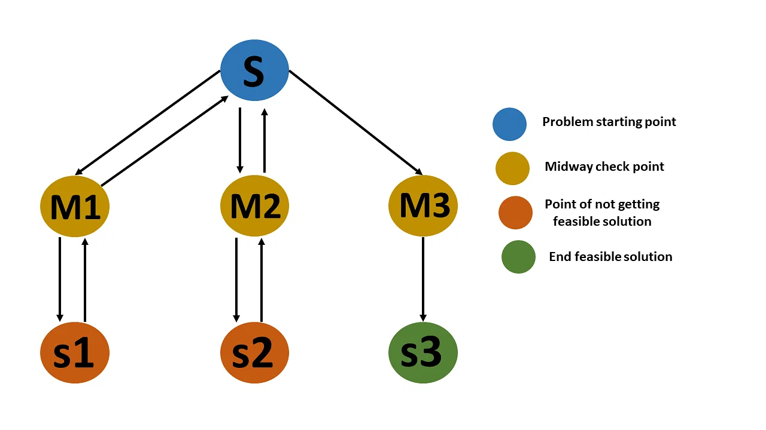
Backtracking Algorithm

